Slide 1


Shayne Voris
April 2, 2024

Slide 2

Outline
Executive Summary
Introduction
Methodology
Results
Conclusion
Appendix

Slide 3
Executive Summary
SpaceX data was examined, using multiple variables to determine factors that impact a successful launch; and to examine whether or not launch performance has increased.
In Summary, SpaceX has improved the success rate of launches as both time, and the number of launches has increased. Improvements in booster design, have also resulted in a higher rate of successful launches. It’s also clear that some launch sites have had a much higher success rate than others.
A predictive model created from the data, can predict, with a relatively high rate of confidence whether or not a future SpaceX launch will be successful.

Slide 4
Introduction
This project is an examination of historical data from past SpaceX Launches.
Has SpaceX improved launch success rates over time?
Are some SpaceX Launch Sites more effective at launching successfully?
Does Payload Mass have a significant impact on the Success Rate?
Are revisions to booster design leading to more successful launches?

Slide 5

Section 1

Slide 6
Methodology
Executive Summary
Data collection methodology:
Launch Data was Collected from SpaceX’s API, as well as Web Scraping from the SpaceX Wikipedia page.
Perform data wrangling
Launch Data was processed to remove any Null values. Launches were grouped by Launch Site, and Orbit type.
Perform exploratory data analysis (EDA) using visualization and SQL
Perform interactive visual analytics using Folium and Plotly Dash
Perform predictive analysis using classification models
How to build, tune, evaluate classification models

Slide 7
Data Collection
SpaceX Launch Data was collected from SpaceX’s own API.
Additional data was Web Scraped from SpaceX’s Wikipedia page.

Slide 8
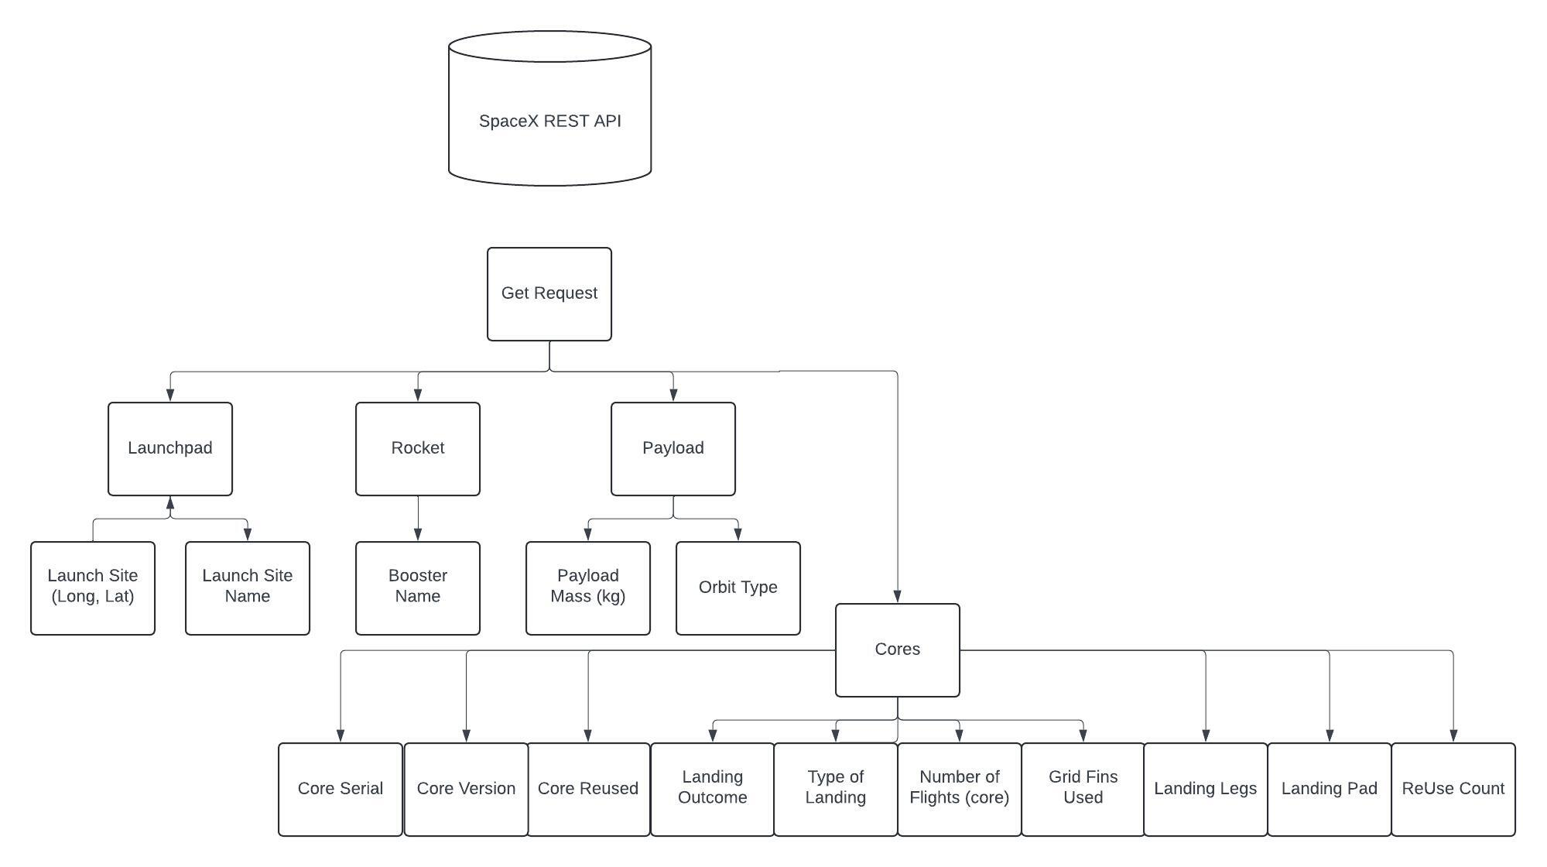
Data Collection – SpaceX API
Present your data collection with SpaceX REST calls using key phrases and flowcharts
https://github.com/SmVoris/Data-Science-Capstone/blob/main/jupyter-labs-spacex-data-collection-api_COMPLETED.ipynb

Slide 9
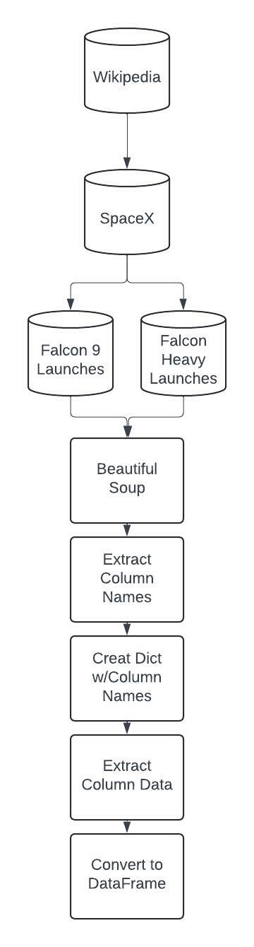
Data Collection - Scraping
Web Scraping Process
https://github.com/SmVoris/Data-Science-Capstone/blob/main/jupyter-labs-webscraping_COMPLETED.ipynb

Slide 10
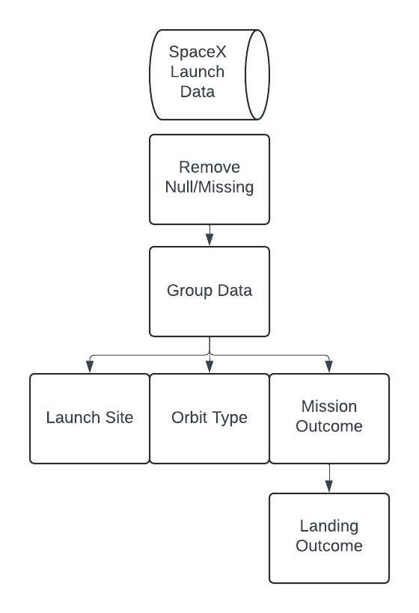
Data Wrangling
Data was processed to remove null values, then grouped to examine the number of launches per site, Orbit Type, and Landing Outcome.
https://github.com/SmVoris/Data-Science-Capstone/blob/main/labs-jupyter-spacex-Data%20wrangling.ipynb

Slide 11
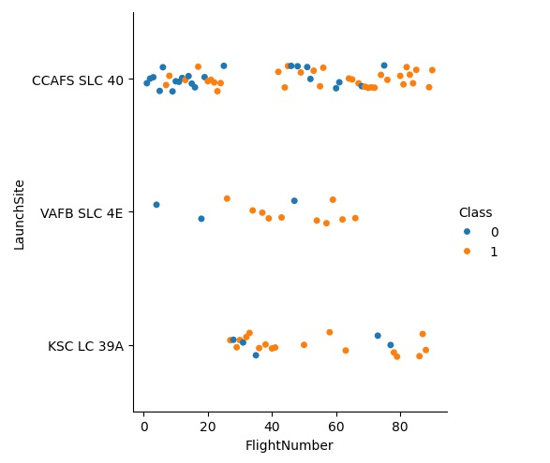
EDA with Data Visualization
Scatter Plots and Bar Plots were used to examine the relationships between: Flight Number, Payload, Launch Site, Orbit Type, and Success Rate.
These charts show how the above variables affect the success of SpaceX Launches.

Slide 12
EDA with SQL
Unique Landing Outcomes
Launch Sites beginning with “CCA”
Total Payload Mass by NASA (CRS)
Average Payload Mass for F9 v1.1
First Successful Ground Pad Landing
Successful Drone Ship Landing for Payload > 4000kg & <6000kg
Total # of Successful and Failure Mission Outcomes
Boosters which have carried Max Payload
Drone Ship Landing Failures for 2015
Ranking Landing Outcomes 2010-06-04 to 2017-03-20
https://github.com/SmVoris/Data-Science-Capstone/blob/main/jupyter-labs-eda-sql-coursera_sqllite.ipynb

Slide 13
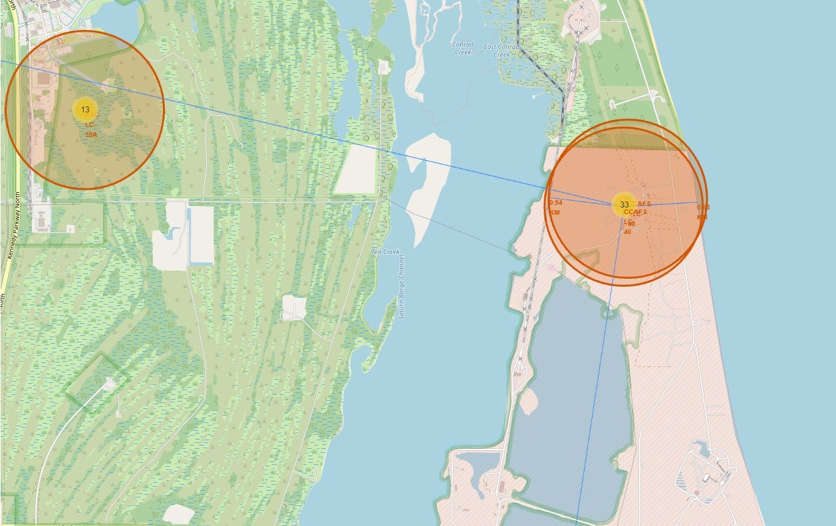
Build an Interactive Map with Folium
Folium Map was created with Markers to denote each SpaceX Launch Site.
Circles were added to show successful and failed launches at each site.
Lines were added to show the distance of Launch Site from nearby highways, railways, and cities.
https://github.com/SmVoris/Data-Science-Capstone/blob/main/lab_jupyter_launch_site_location.jupyterlite_COMPLETED.ipynb

Slide 14
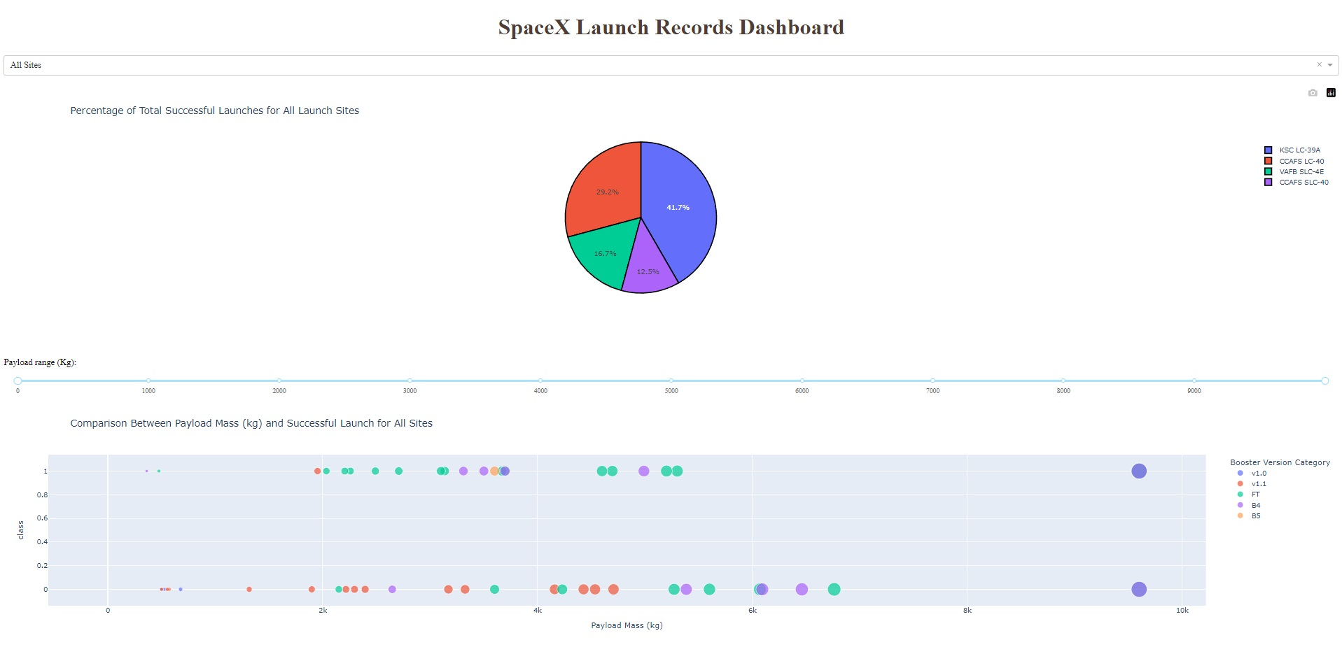
Build a Dashboard with Plotly Dash
Pie charts were used to show which Launch Sites had the highest percentage of Successful Launches.
As well as showing Success vs Failure for each individual site.
A Scatter chart was used to show the relationship between Payload Mass and Success vs Failure for all sites, and for each individually selected site.
https://github.com/SmVoris/Data-Science-Capstone/blob/main/spacex_dash_app.py

Slide 15
Predictive Analysis (Classification)
Models were constructed using the Cleaned SpaceX Launch Data, to predict the likelihood of a successful launch.
Features were converted to Feature Arrays to train the models, using train_test_split to separate the data into Training and Testing sets.
Logistic Regression, Support Vector Machine, Decision Tree, and KNN models were evaluated and compared.
After evaluation of the Accuracy Score, and Confusion Matrix for each model type, it was determined that the Decision Tree Model had the highest accuracy at 87.6%.
https://github.com/SmVoris/Data-Science-Capstone/blob/main/SpaceX_Machine_Learning_Prediction_Part_5.jupyterlite%20(1).ipynb

Slide 16
Results
Exploratory Data Analysis results
Interactive analytics demo in screenshots
Predictive analysis results

Slide 17

Section 2

Slide 18
Flight Number vs. Launch Site
Show a scatter plot of Flight Number vs. Launch Site
Class “1” = Success
Class “0” = Failure

Slide 19
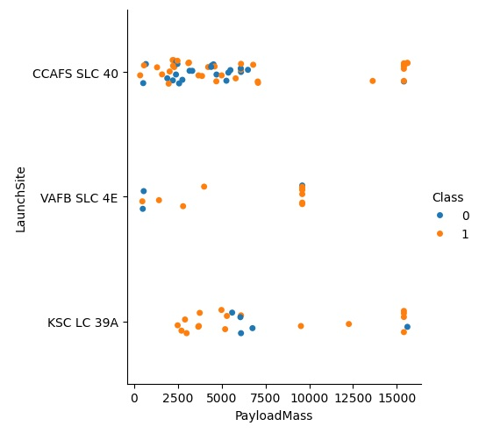
Payload vs. Launch Site
Scatter plot of Payload vs. Launch Site
Launches with 7,500kg + Payload Mass have a higher Success Rate at all Sites.

Slide 20
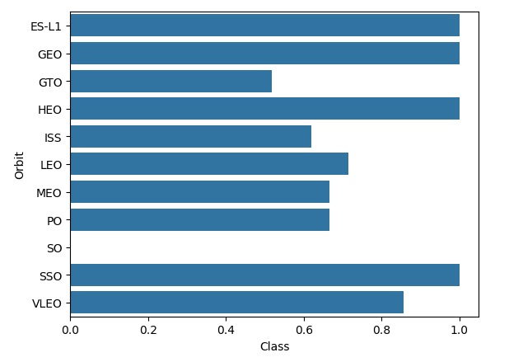
Success Rate vs. Orbit Type
Bar chart for the success rate of each orbit type
ES-L1, GEO, HEO, and SSO Orbits have a 100% Success Rate

Slide 21
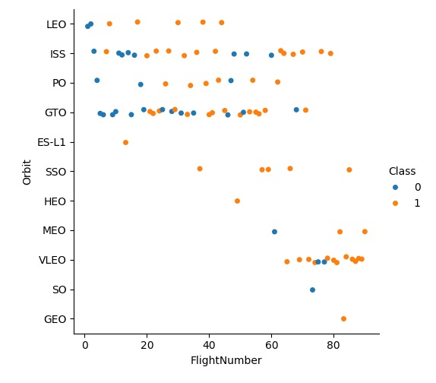
Flight Number vs. Orbit Type
Scatter point of Flight number vs. Orbit type
Success Rate for most Orbits has increased with more Flights.

Slide 22
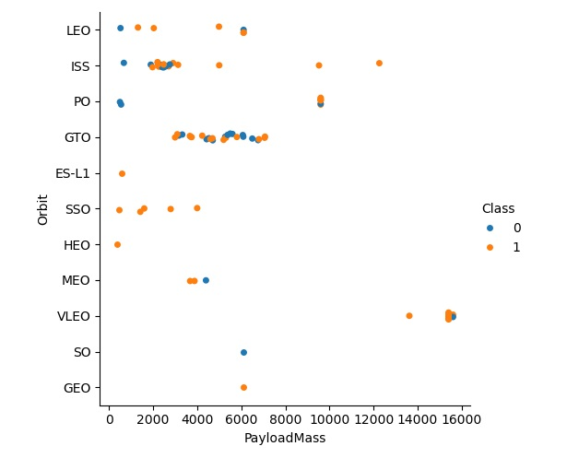
Payload vs. Orbit Type
Show a scatter point of payload vs. orbit type
Payloads greater than 8,000kg have only been attempted for ISS, PO, and VLEO Orbits.

Slide 23
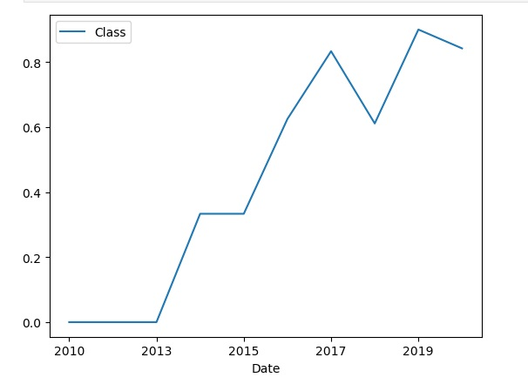
Launch Success Yearly Trend
SpaceX Launch Success Rate by Year

Slide 24
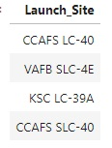
All Launch Site Names
List of 4 Unique SpaceX Launch Sites

Slide 25
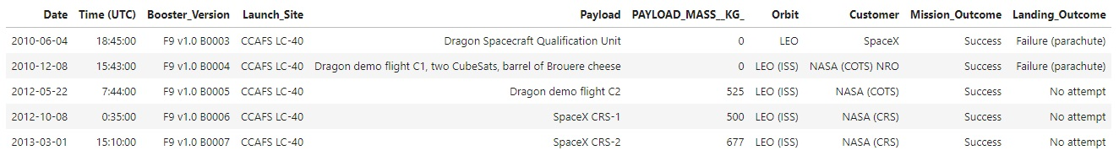
Launch Site Names Begin with 'CCA'
5 Records from Launch Sites beginning with “CCA”.

Slide 26
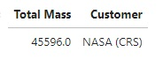
Total Payload Mass
Total Payload Mass (kg) for Customer: NASA (CRS)

Slide 27
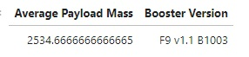
Average Payload Mass by F9 v1.1
Average Payload Mass (kg) carried by Booster Version F9 v1.1

Slide 28

First Successful Ground Landing Date
First Successful Ground Pad Landing Date

Slide 29
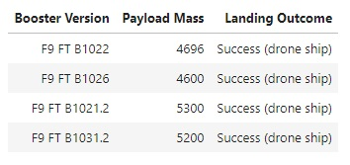
Successful Drone Ship Landing with Payload between 4000 and 6000
Falcon 9 Boosters that have achieved a Successful Drone Ship Landing, with Payload Mass greater than 4000kg, and less than 6000kg.

Slide 30
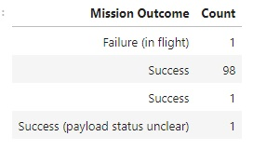
Total Number of Successful and Failure Mission Outcomes
Total Number of Successful and Failure Mission Outcomes.

Slide 31
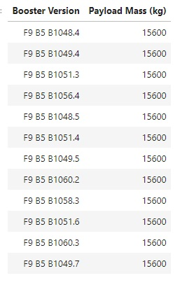
Boosters Carried Maximum Payload
Booster which have carried the Maximum Payload Mass of 15,600kg.

Slide 32
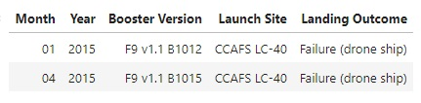
2015 Launch Records
Launches in 2015 that Failed to land on Drone Ship.

Slide 33
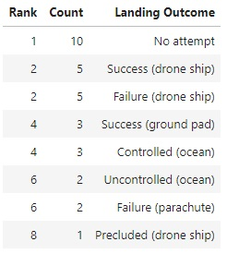
Rank Landing Outcomes Between 2010-06-04 and 2017-03-20
Rank of the Number of Landing Outcomes by Landing Outcome Type, between 2010-06-04 and 2017-03-20.

Slide 34

Section 3

Slide 35
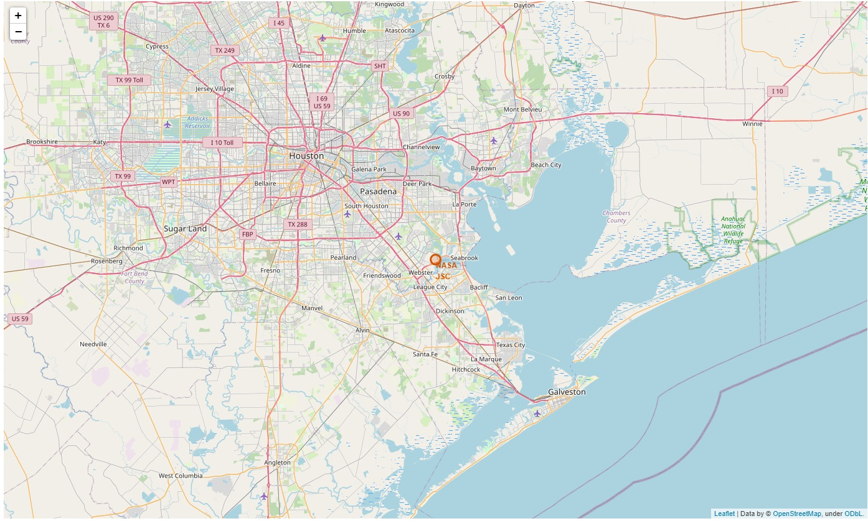
Folium Map – NASA Johnson Space Center
Johnson Space Center
Houston, TX
Lat: 29.559684888503615
Long: -95.0830971930759

Slide 36
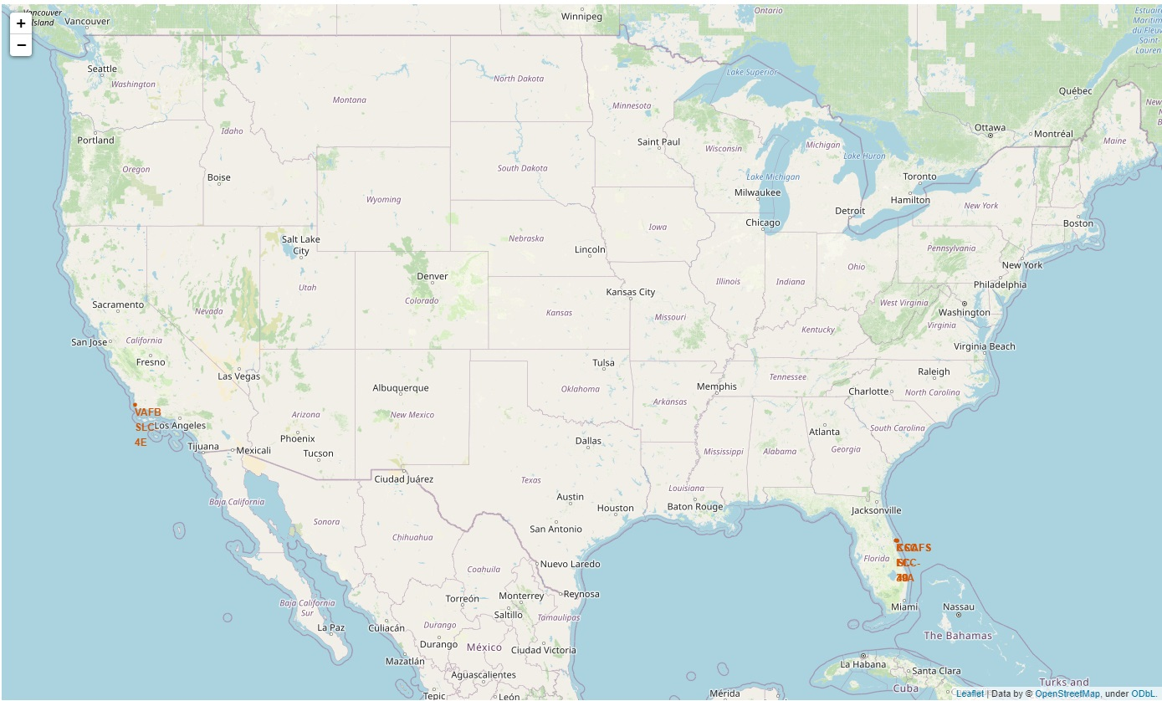
SpaceX Launch Sites

Slide 37
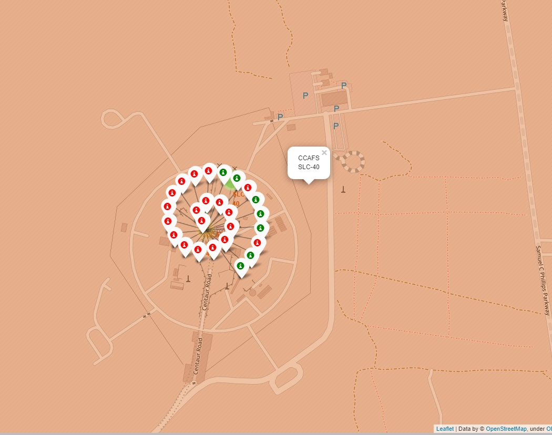
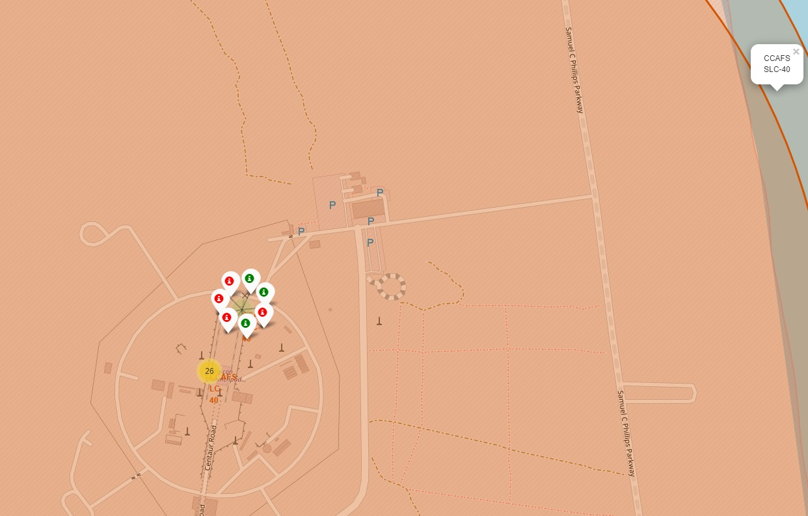
SpaceX Launch Sites
CCAFS-LC-40
CCAFS-SLC-40

Slide 38
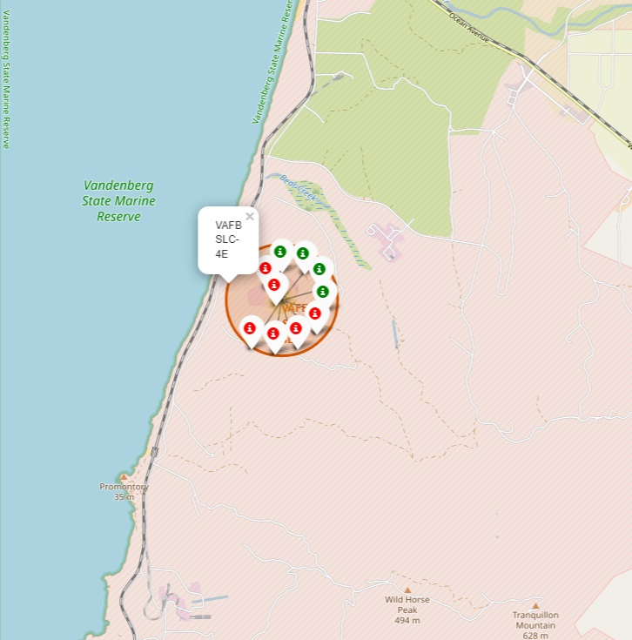
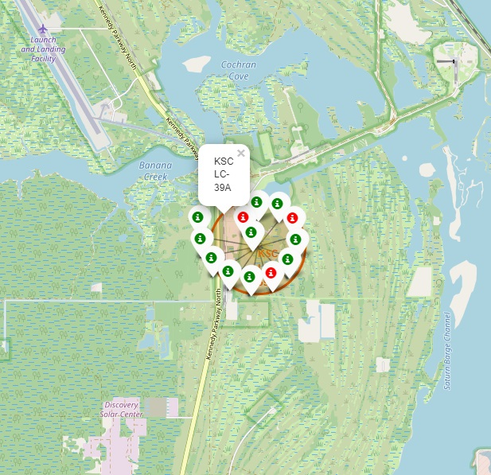
SpaceX Launch Sites
VAFB-SLC-4E
KSC-LC-39A

Slide 39
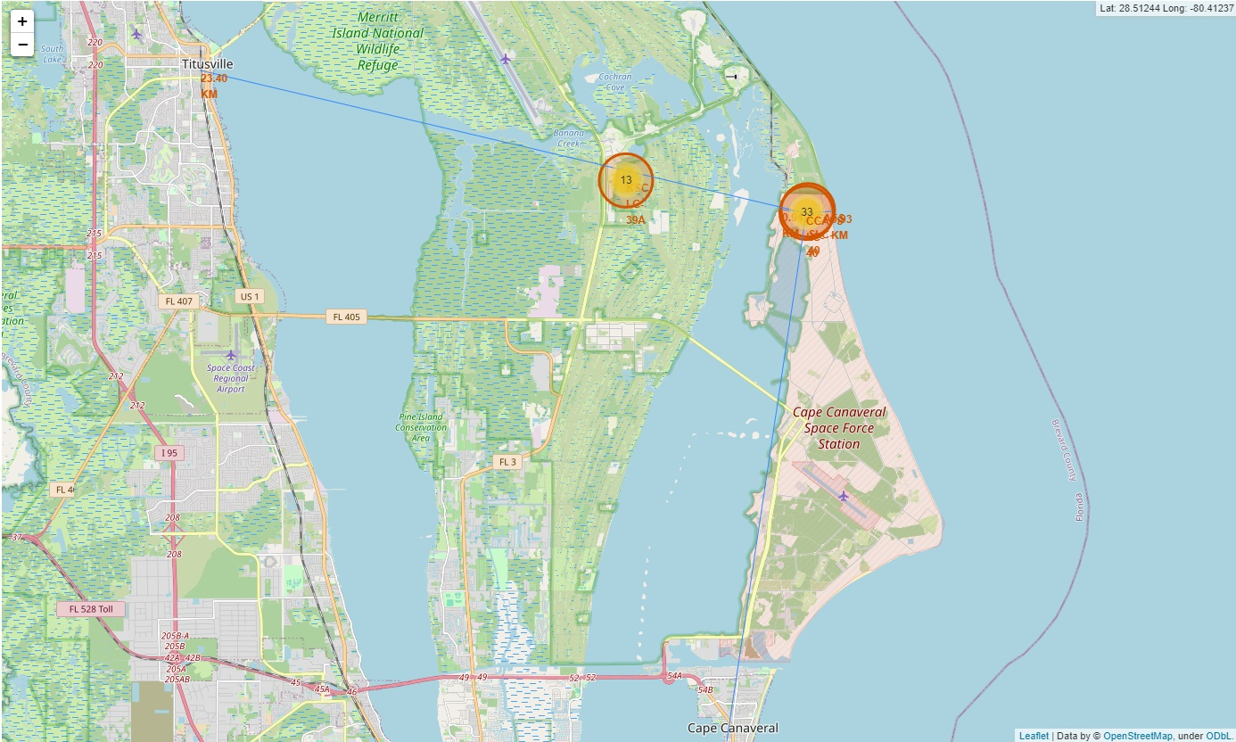
Launch Site Proximity to Cities
Titusville:
23.4km
Cape Canaveral:
20.11km

Slide 40
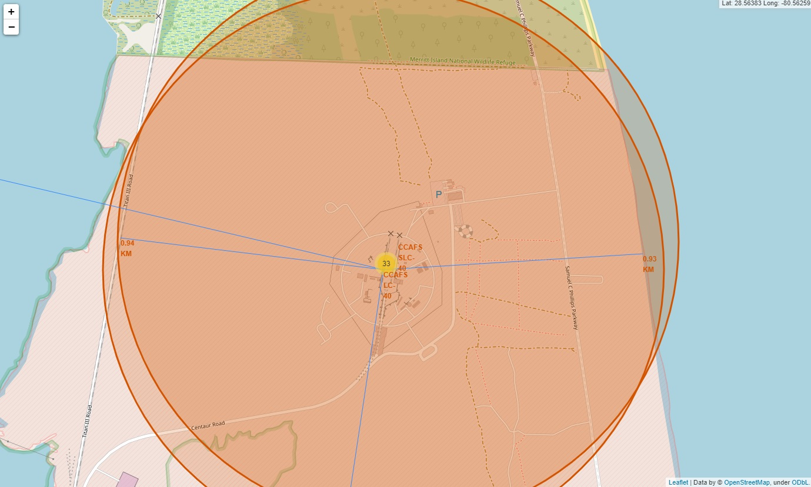
Launch Site Proximity to Railway and Coast
Rail:
0.94km
Coastline:
0.93km

Slide 41

Section 4

Slide 42
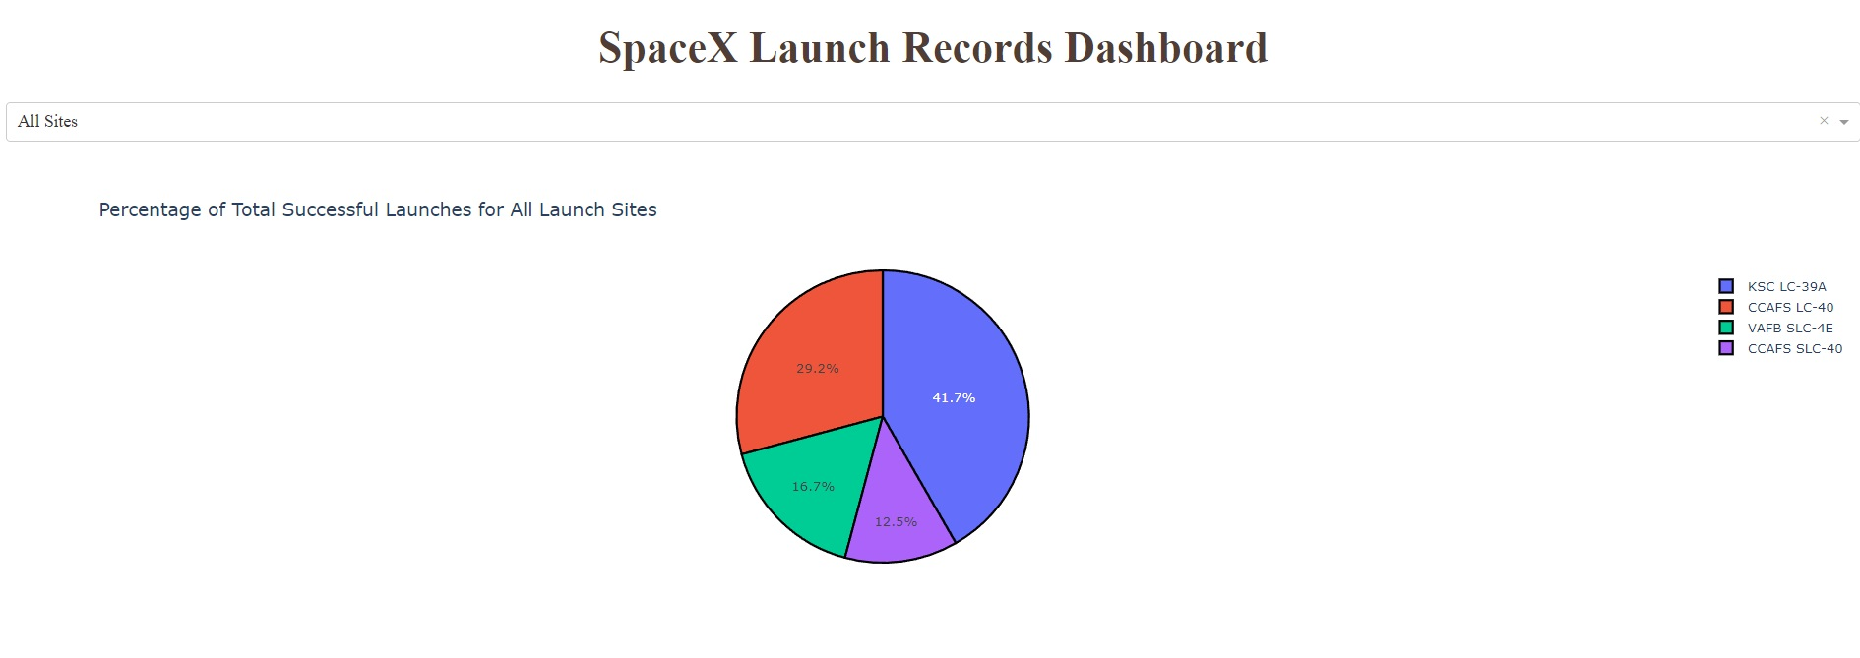
Dashboard – Success Count – All Sites
KSC LC-39A is the Most Successful Launch Site, With 41.7% of All Successful Launches.

Slide 43
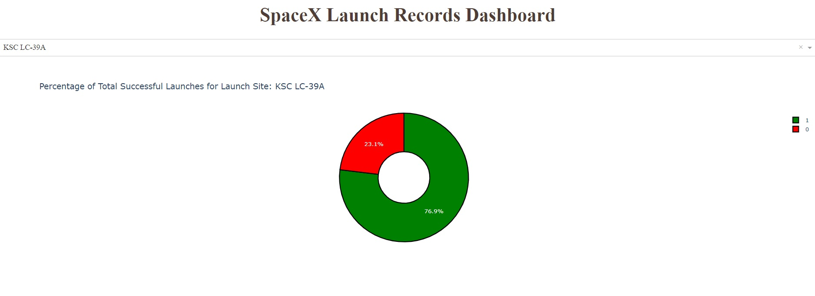
KSC LC-39A Success Rate
76.9% of Launches from KSC LC-39A Have been Successful.

Slide 44
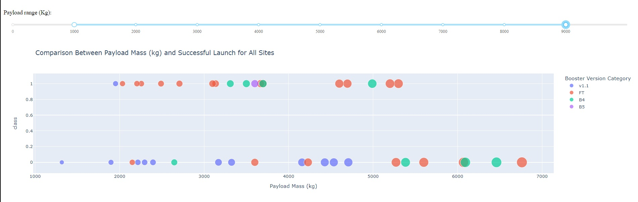
Payload Range for All Sites
Payload Range from 2000-5000kg shows the greatest Success Rate
Booster v1.1 has the greatest Failure Rate
Booster B5 has 100% Success Rate, but only 1 recorded Launch
Booster FT has the greatest Success Rate for Multiple Launches

Slide 45
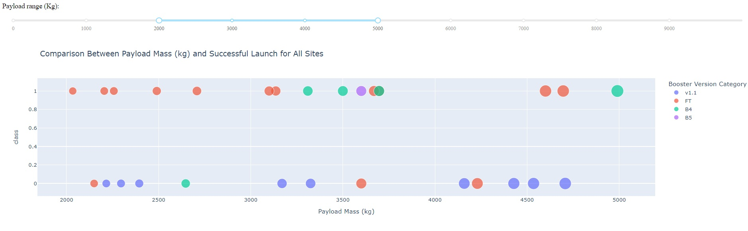
Payload Range 2000 – 5000 kg

Slide 46

Section 5

Slide 47
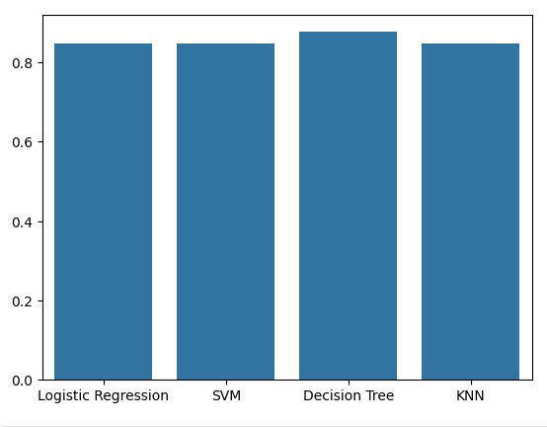
Classification Accuracy
Decision Tree Model has highest classification accuracy: 87.6%

Slide 48
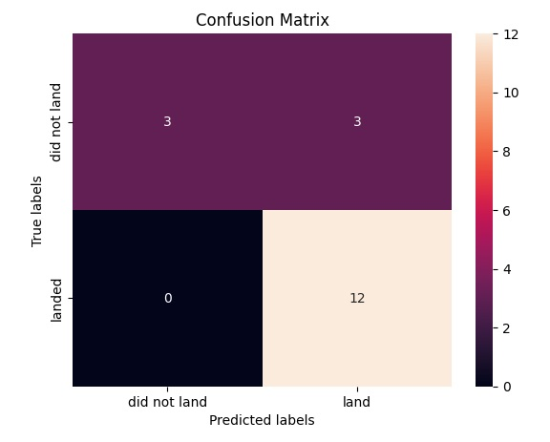
Confusion Matrix
Decision Tree Model Confusion Matrix
Shows 80% Accuracy at predicting Landings. Predicting 12 out of 15 correctly.
Shows 100% accuracy at predicting Failure to Land. Predicting 3 out of 3 correctly.

Slide 49
Conclusions
SpaceX has consistently improved performance, and Success Rates as the number of Flights has increased.
KSC LC-39A: (Kennedy Space Center Launch Complex 39A) Has been the most Successful Launch Site with 76.9% Success Rate.
Booster version FT has been the most successful booster version.
Payloads between 2000 kg and 5000 kg, and above 7,500 kg have the greatest Success Rates.

Slide 50
Appendix
Include any relevant assets like Python code snippets, SQL queries, charts, Notebook outputs, or data sets that you may have created during this project

Slide 51


